Slide 1
Advanced Regression Techniques To Predict Housing Prices
By
Daniel Bradley, Nate Berman and Peter Shapiro

Slide 2
The Business Problem
Current User State: Inexperienced home buyers can be limited in resources to accurately predict its true value
The Goal: create a tool that can accurately predict the price of homes based off of the most important features
Benefit: An accurate model will allow home buyers to identify undervalued homes and save more money overall
Real Estate Agents
Houses in close proximity
Online information

Slide 3
The Data
Kaggle DataSet(https://www.kaggle.com/c/house-prices-advanced-regression-techniques/data)
1,460 homes in Ames, Iowa
81 explanatory variables for almost every home
Categorical and numerical data features
6,965 null values

Slide 4
Frame The Problem
Supervised learning task-
We know the outcome ( each instance comes with house prices)
01
Multiple Regression-
Multiple attributes/features- uses multiple features to make the prediction
02
Univariate Regression-
We are only trying to predict one outcome
03
Batch learning because it is small enough to fit into local memory
04

Slide 5
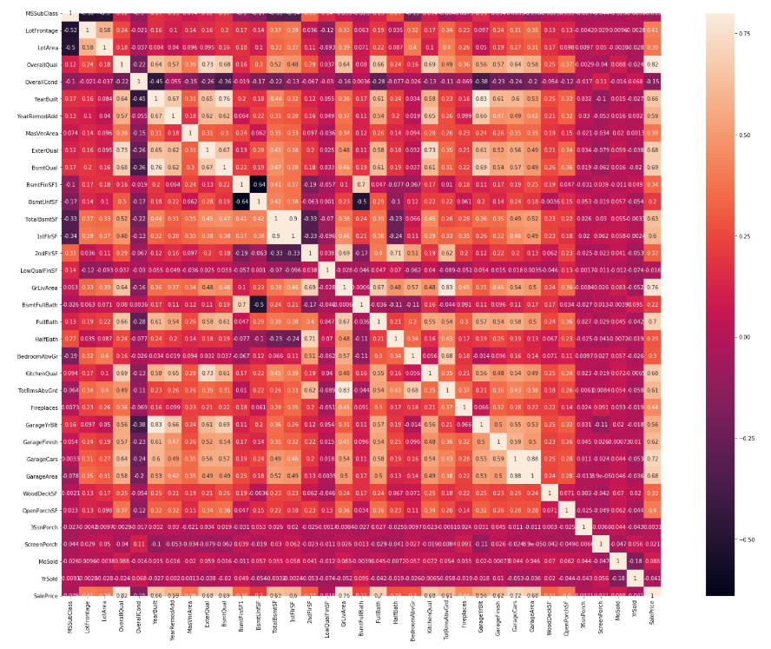
Ordinary Least Squares Multiple Regression
Goal: Minimize the sum of square differences between observed and predicted values
Normalized the price feature with the natural log (originally skewed right)
Eliminated all categorical data and initially focused on numeric
Median()
Mean()
Testing score was in the mid 80’s
Used seaborn correlation heat map to eliminate clear, uncorrelated features

Slide 6
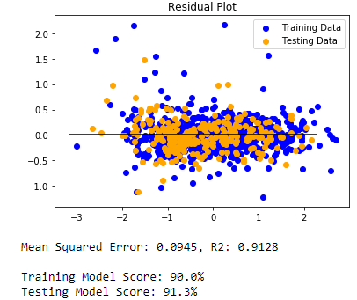
Exploring The Data
Converted categorical data to numeric and included the highest correlated features in the model
Resulted in 33 features and 91.3% testing accuracy
Utilized recursive feature elimination to find the optimal number of features
Resulted in 13 features
However, when those features were used and tested, the accuracy of the testing model dropped

Slide 7
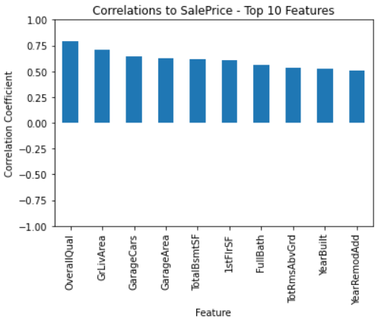
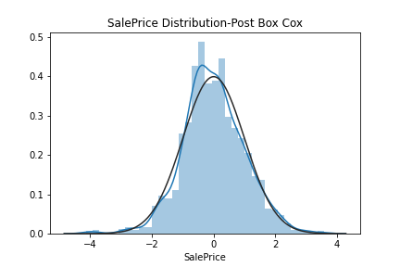
Nate-Lasso Regression
I first wanted to review all the numerical features and their correlation to SalePrice. This provided me with the features that I will use for the train set.
After cleaning data, I looked to make sure the data followed a normal distribution. It was not.
I used a box-cox to transform the data to a normal distribution.

Slide 8
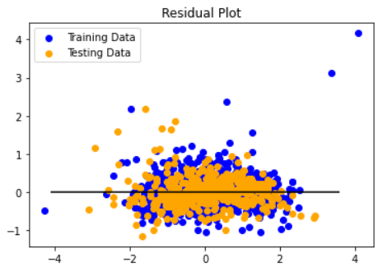
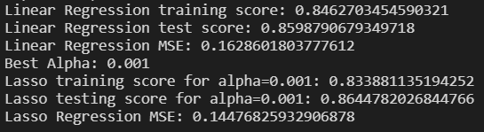
Lasso Regression
The data set was divided into a train and test set where GridSearchCV was used to get the best alpha and train and test the data with a Lasso Regression.
The best alpha was 0.001
Train set had 977 records and 15 features
Test set had 977 records to predict SalePrice
Compared to a standard linear regression it had slightly improved results, 0.05 and a lower MSE, 0.017
Based on the density of the residual plot, we can see high levels of accuracy however we are able to identify some outliers in the training set.

Slide 9
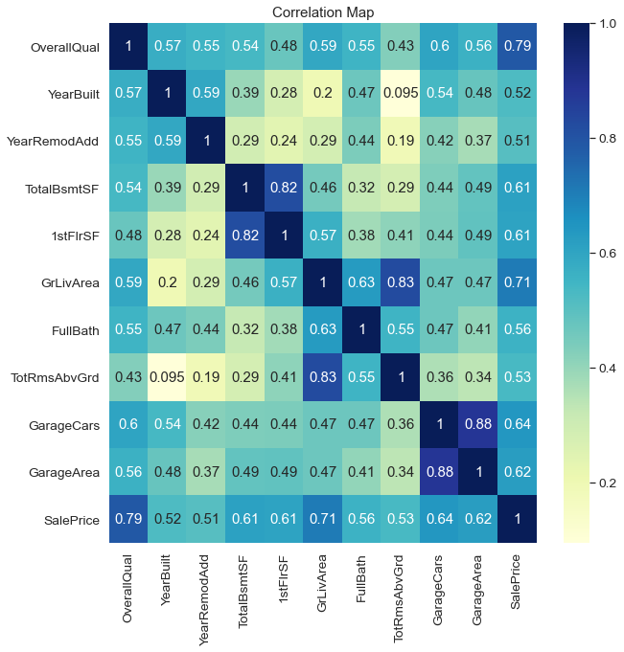
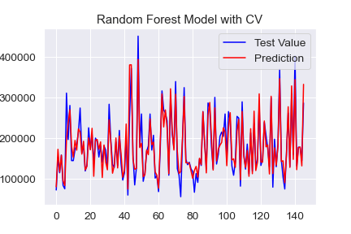
Daniel

Slide 10
Comparison
Model | No. Features | Training R² | Testing R² | MSE
Simple Model | 1 | 0.618 | 0.686 | 1814796444.73
Random Forest | 10 | 0.978 | 0.867 | 729555657.23
Random Forest CV | 10 | 0.917 | 0.883 | 654125368.41
Lasso | 15 | 0.834 | 0.865 | 0.145
OLS | 33 | 0.913 | 0.900 | 0.094

Slide 11
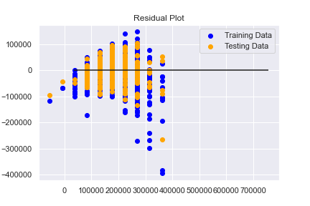
Simple Model
Model Type | Training R² | Testing R² | MSE
Single Feature OLS | 0.618 | 0.686 | 1814796444.73

Slide 12
Backmatter

Slide 13
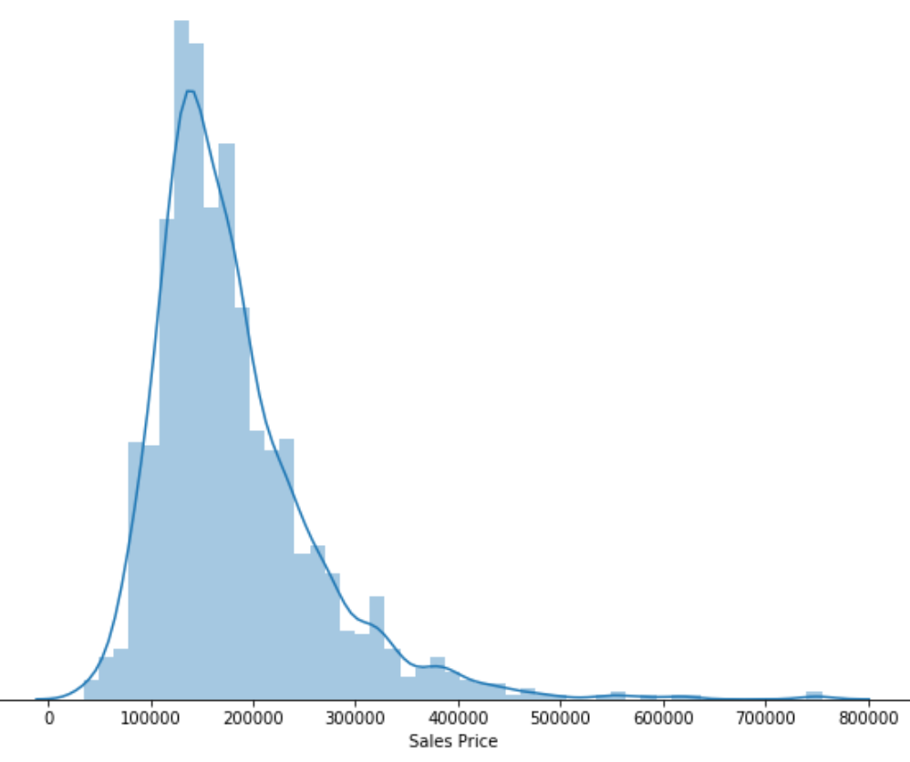
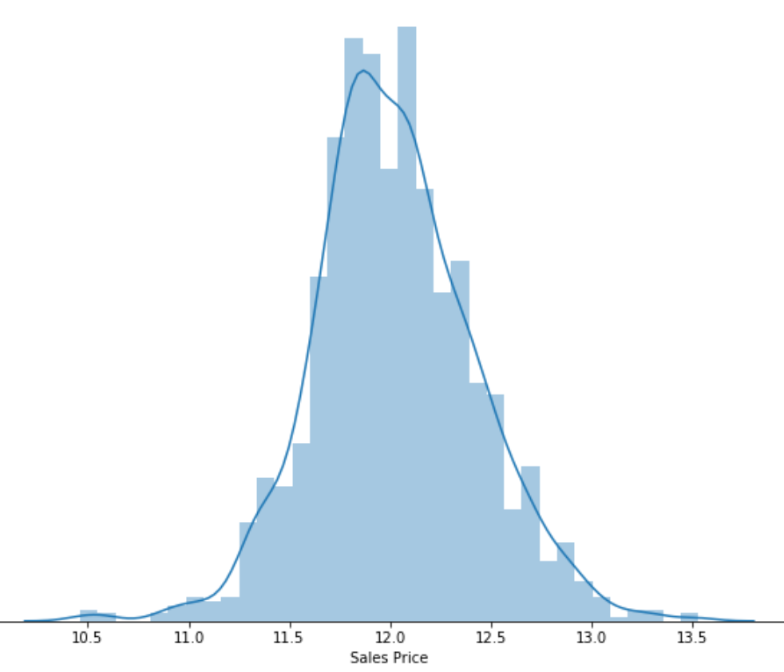
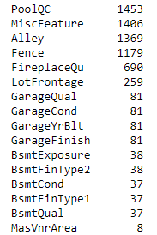
Exploring The Data
Null Values
Natural Log to normalize the data
All null values reduced to 0

